Slide 1


COFFEE SHOP
Facility Layout
Facility

Slide 2
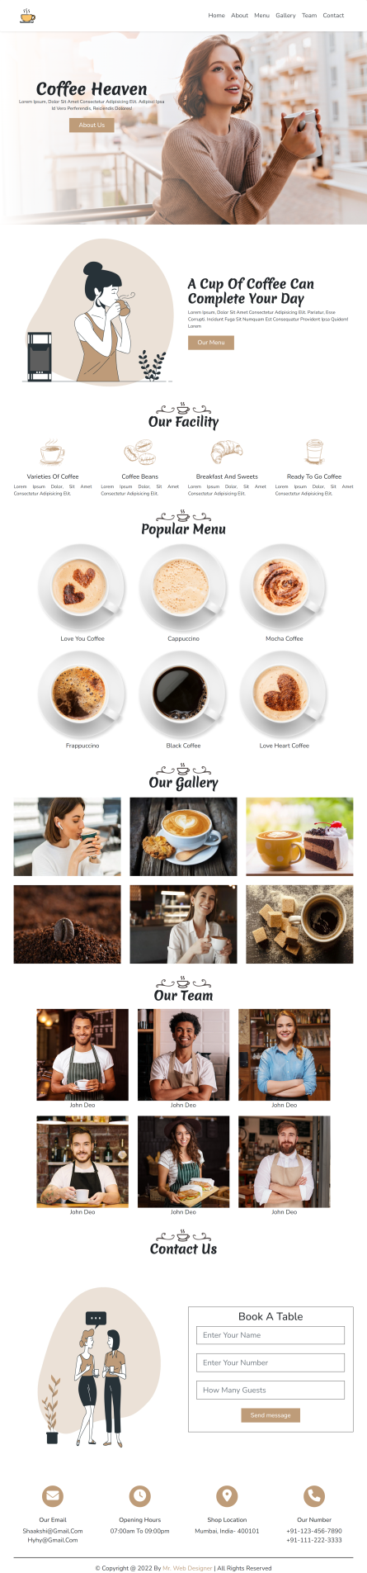
Layout Design
Components
Total number of Components
Parent Containers Of Any website
Number of Components in Coffee Shop Website
1. header
1.navBar
2. main
2.heroSection
3. footer
3.about
4.facility
5.menu
6.gallery
7.team
8.contact
9.contactIcons

Slide 3
Layout Design
Components
Total number of Components
Containers
1. header
1.navBar
2.heroSection
2. main
3.about
4.facility
5.menu
6.gallery
7.team
3. footer
8.contact
9.contactIcons

Slide 4
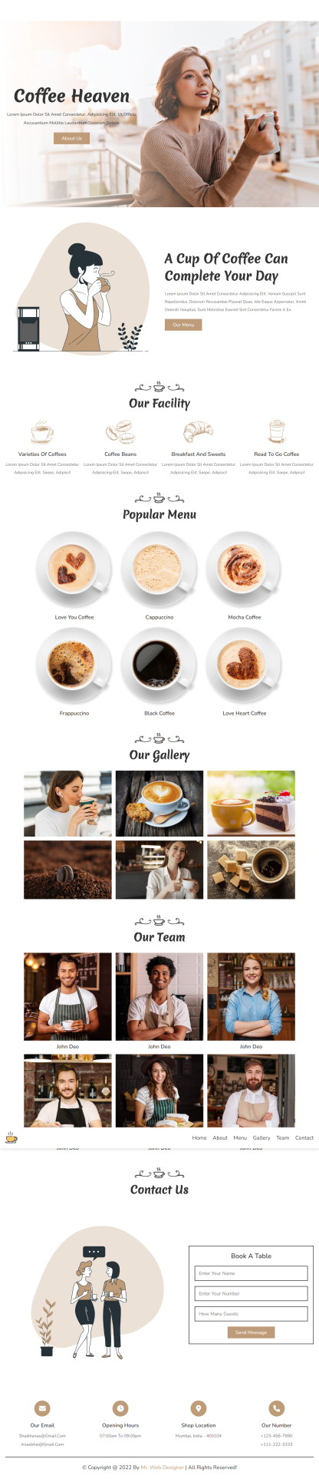
Layout Design
Components
How to Group Components into the Parent Containers
1.navBar
1. header
2.heroSection
3.about
4.facility
2. main
5.menu
6.gallery
7.team
3. footer
8.contact
9.contactIcons

Slide 5
Facility

Slide 6
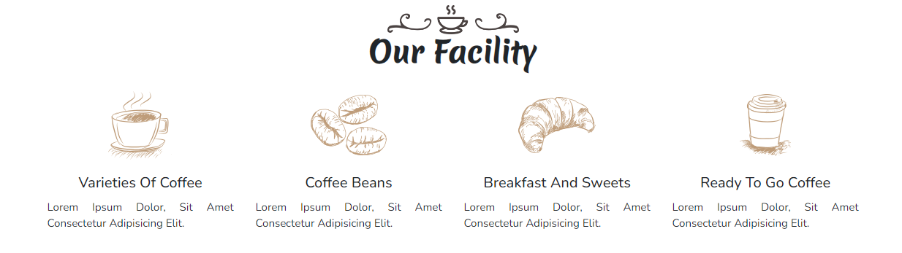
Layout Design
Containers
4.Facility

Slide 7
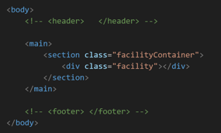
Layout Design
Containers
4.Facility
main
facilityContainer
facility

Slide 8
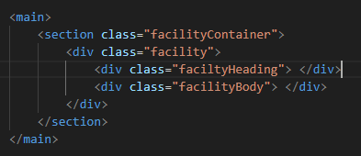
Layout Design
Containers
4.Facility
main
facilityContainer
facility
facilityHeading
facilityBody

Slide 9
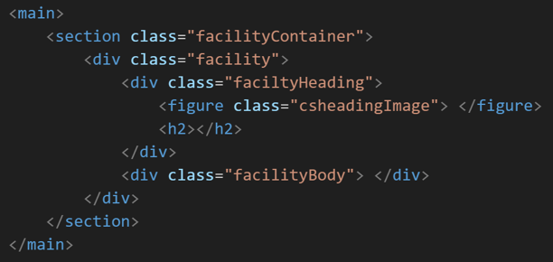
Layout Design
Containers
4.Facility
main
<h2>
facilityContainer
<h2>
facility
facilityHeading
facilityBody
csheadingImage

Slide 10
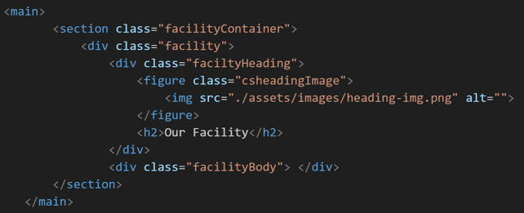
Layout Design
Containers
4.Facility
main
<h2>
<img>
facilityContainer
<img>
<h2>
facility
facilityHeading
facilityBody
csheadingImage

Slide 11
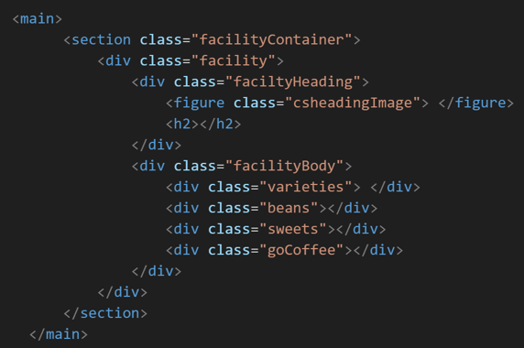
Layout Design
Containers
4.Facility
main
<h2>
<img>
facilityContainer
<img>
<h2>
facility
facilityHeading
facilityBody
csheadingImage
varieties
beans
sweets
goCoffee

Slide 12
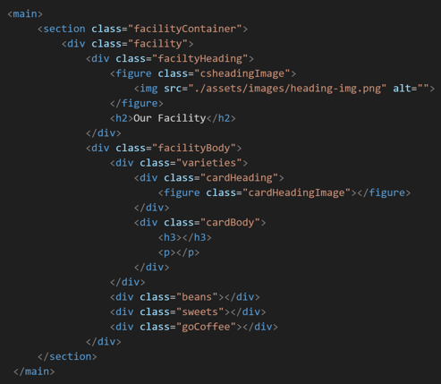
Layout Design
Containers
4.Facility
main
<h2>
<img>
facilityContainer
<img>
<h2>
facility
cardheading
facilityHeading
cardBody
facilityBody
csheadingImage
varieties
beans
sweets
goCoffee

Slide 13
Layout Design
Containers
4.Facility
main
<h2>
<img>
facilityContainer
<img>
<h2>
facility
cardheading
facilityHeading
cardBody
facilityBody
cardHeadingImage
csheadingImage
varieties
beans
sweets
goCoffee

Slide 14
Layout Design
Containers
4.Facility
main
<h2>
<img>
facilityContainer
<img>
<h2>
facility
cardheading
facilityHeading
cardBody
facilityBody
<img>
cardHeadingImage
csheadingImage
<img>
varieties
beans
sweets
goCoffee

Slide 15
Layout Design
Containers
4.Facility
main
<h2>
<img>
facilityContainer
<img>
<h2>
facility
cardheading
facilityHeading
cardBody
facilityBody
<img>
cardHeadingImage
csheadingImage
<img>
varieties
<h3>
<h3>
beans
<p>
sweets
<p>
goCoffee

Slide 16
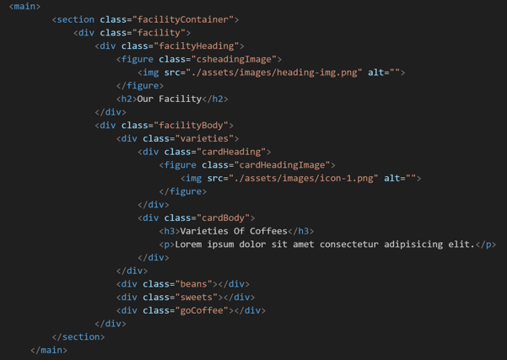
Layout Design
Containers
4.Facility
main
<h2>
<img>
facilityContainer
<img>
<h2>
facility
cardheading
facilityHeading
cardBody
facilityBody
<img>
cardHeadingImage
csheadingImage
<img>
varieties
<h3>
<h3>
beans
<p>
sweets
<p>
goCoffee

Slide 17
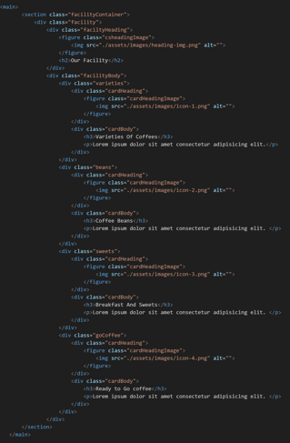
Layout Design
Containers
4.Facility
main
<h2>
<img>
facilityContainer
<img>
<h2>
facility
cardheading
facilityHeading
cardBody
facilityBody
<img>
<img>
<img>
<img>
cardHeadingImage
csheadingImage
<img>
<h3>
<h3>
<h3>
<h3>
varieties
<h3>
beans
<p>
<p>
<p>
<p>
sweets
<p>
goCoffee

Slide 18
Containers
Html STRUCTURE
4.Facility

Slide 19
Html Structure
Facility
parentContainer
componentContainer
component
componentChild
childOfChild
childOfChild
content
Container
contentContainer
Content
content
Parent
Container
component
Container
component
componentChild
childOfChild
content
Container
content
facilityHeading
facilityBody
csHeadingImage,varities,beans,sweets,goCoffee,cardHeadingImage
cardHeading
cardBody
<img> <h2> <p>&<h3>
Img,Our facility,Varieties etc
main
facilitycontainer
facility
main
aboutcontainer
about
imageContainer
<img> <p>&<h1>
Img,A cup of&our menu etc…

Slide 20
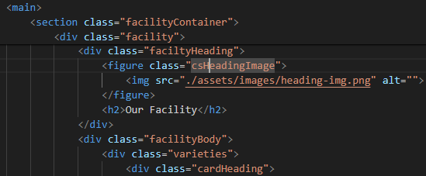
Html Structure
Facility
parentContainer
componentContainer
component
componentChild
childOfChild
content
Container
Content
Parent
Container
component
Container
component
componentChild
childOfChild
content
Container
content
facilityHeading
facilityBody
csHeadingImage,varities,beans,sweets,goCoffee,cardHeadingImage
cardHeading
cardBody
<img> <h2> <p>&<h3>
Img,Our facility,Varieties etc
main
facilitycontainer
facility
main
aboutcontainer
about
imageContainer
<img> <p>&<h1>
Img,A cup of&our menu etc…

